Slide 1
Rocket Launch and Database
B.Tech F.Y.
Division P Batch 2
23 - 12110322 - Sandesh Kawane
Problem Solving and Programming Course Project
Department of Engineering, Sciences and Humanities (DESH)
Vishwakarma Institute of Technology, Pune
A.Y.(2021-2022) Term I

Slide 2
OUTLINE
Introduction
problem statement
objectives
background
Implementation
Results and discussion
Conclusion and Future Scope
References

Slide 3
Introduction
Simulates Various Rocket Launches in C
Stores Data of Each SLV (Rocket)
Data can be 1) Read
2) Written
3) Edited
4) Deleted
Extensive use of “graphics.h” Library and File Handling

Slide 4
problem statement
1 Simulation of Rocket of Various Names and Maintain Data of Launches

Slide 5
objectives
Make a Rocket using Library Function
Make a Rocket move w.r.t Time
Stores Data of SLV’s with Successful Launches
Rough Idea of Available SLV’s
Simulation
Authorized Control to Manage Data

Slide 6
background
Only the Graphical Part existed
Couldn’t Store Proper Data
Lack of Database
No Authorized Control

Slide 7
Implementation
Category of the project
Application – Main Purpose is Simulation and Analyzing (Database)
Tools / Platform.
- C/C++ (Graphics and File Handling)
Front end-Backend Software Requirement
- NA

Slide 8
Implementation (Cont.)
Modules / Features
Displays Various SLV’s
Simulates Rocket Launch
Manages Data
Authorized Control for Managing Data

Slide 9
Implementation (Cont.)
System Architecture
Start
Input the Number for a Rocket to be launched
Displays Database
Generates Rocket and Takes Number for Rocket from Input
Simulates the Rocket
Updates Database

Slide 10
Implementation (Cont.)
Overall Algorithm
Start
Declare Structure Launchdata (Character Array: rocketname[10], Integer launches=0)
Declare Variables i1,n=0,k,j1=0, *rocketname[5][10]
Copy rocketname from Structure to pointer rocketname[]
While Loop
Verify Credentials
Print “Enter 1. Launched Rockets and 2. Launch New Rocket”
If 1
Display Data of Launched Rockets
4) If 2
Launch Specified Name Rocket
6. Exit

Slide 11
Implementation (Cont.)
Overall Flowchart
Start
Structure launchdata( Variables Character: rocketname[10], Integer: launches=0
Declare File Pointer and Variables i1, n, k, j1
Assign Name of each Rocket
While
Print “Enter 1. Launched Rockets 2.Launch New Rocket”
1
Print Launched Rockets with Name
2
Launch Respective Rocket

Slide 12
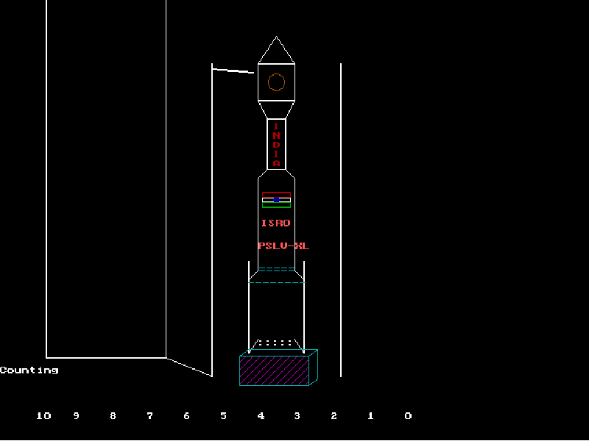
Results and discussion

Slide 13
Conclusion and Future Scope
Conclusion
Simulates Various Rockets
Handles Rocket Database
Future Scope
Different and up to the Scale Models can be introduce
Various Stages of the Rockets ( showing leaves earth atmosphere and etcetera )

Slide 14
Contribution
Example
Div P Batch B2
Roll No 23 – GRNo – 12110322 – Sandesh Kawane
Rocket Modeling
Rocket Coding
Introducing Various SLV’s
File Handling
Data Management
Programming

Slide 15
References
Github – Shivamv12 (Launching – Rocket)

Slide 16
Thank You!

